Slide 1
Community Infrastructure &Development Current Planning
Rezoning Application
ZON00296
7250 Hitchcock
October 9, 2018

Slide 2
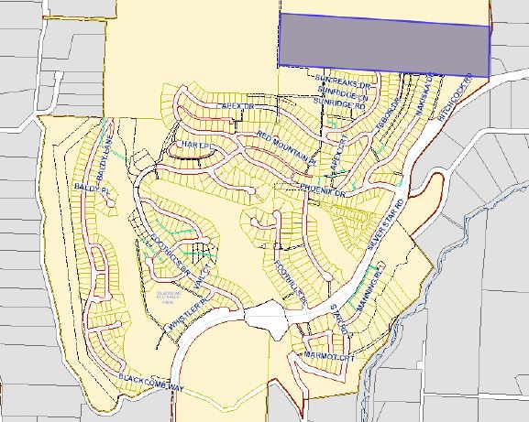
SUBJECT PROPERTY
RDNO
Hitchcock Rd
SILVER STAR RD
RDNO
Location Map

Slide 3
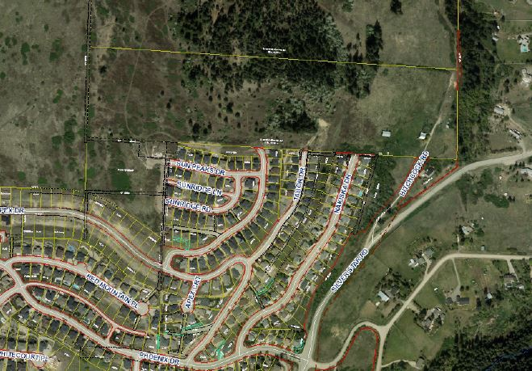
SUBJECT PROPERTY
RDNO
HITCHCOCK RD
SILVERSTAR RD
Location Map - Aerial

Slide 4
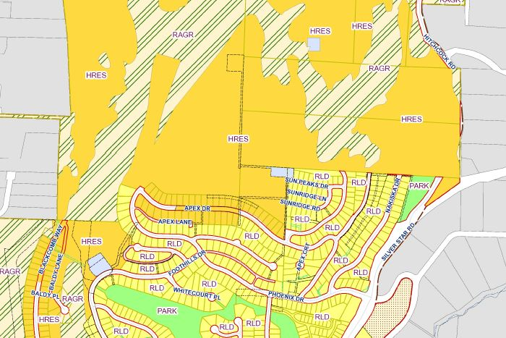
RDNO
SUBJECT PROPERTY
HITCHCOCK RD
SILVERSTAR RD
RDNO
HRES – Hillside Residential RAGR – Rural/Agricultural
PUBINS – Public & Institutional
PARKS – Open Space
RLD – Residential – Low Density
OCP Designation

Slide 5
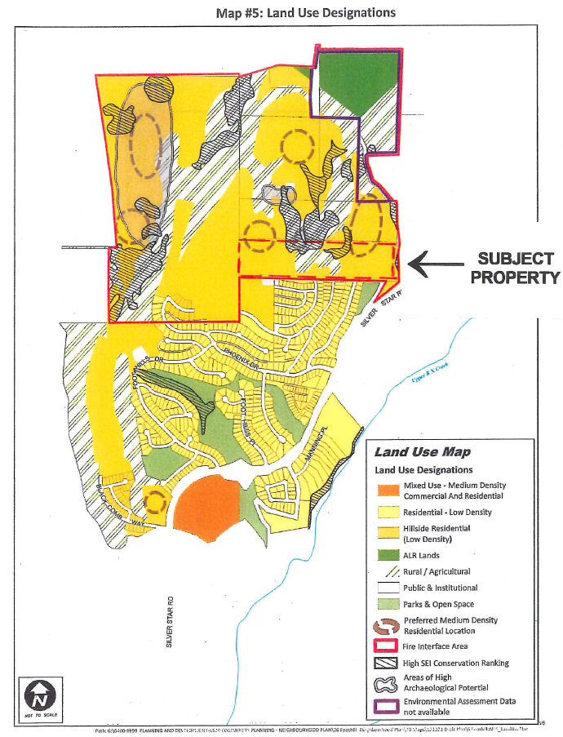
Foothills Neighbourhood Plan

Slide 6
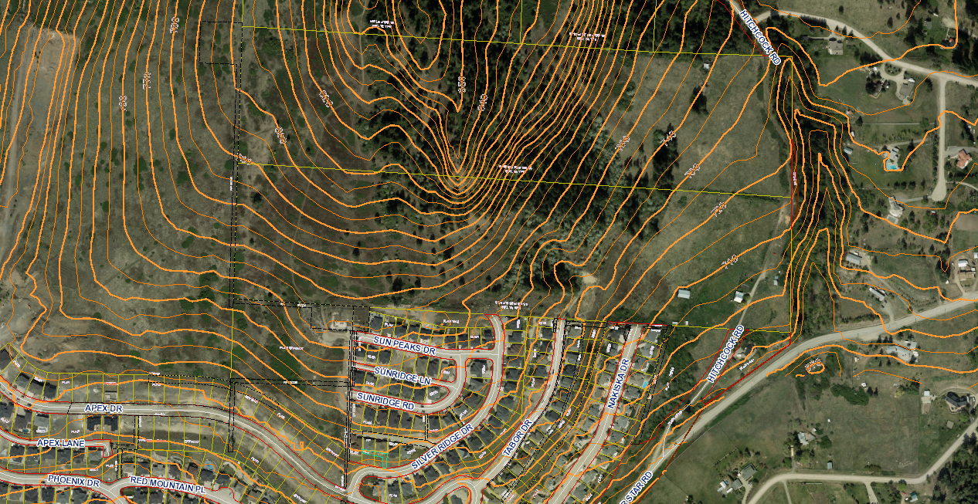
Topography

Slide 7
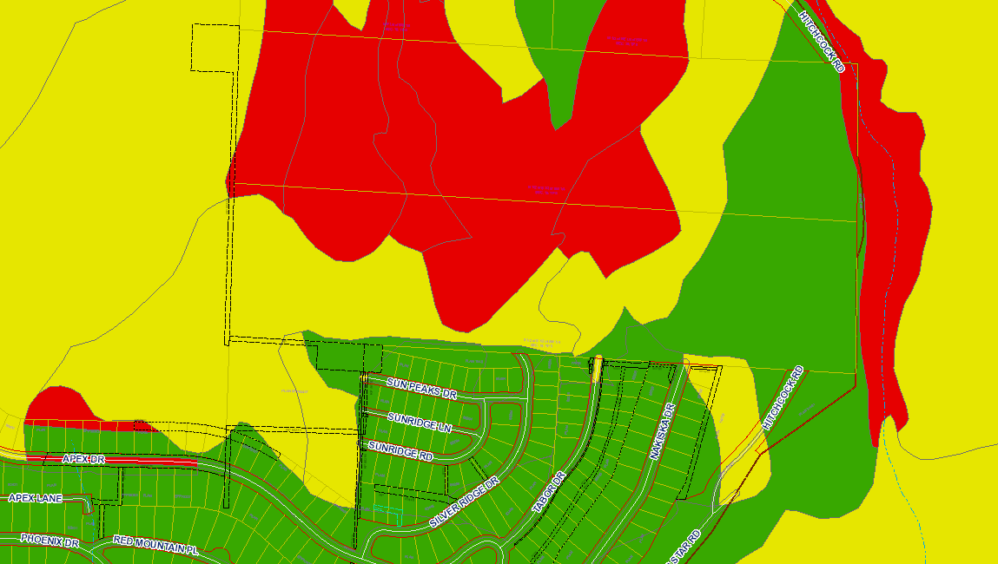
EMA Designation

Slide 8
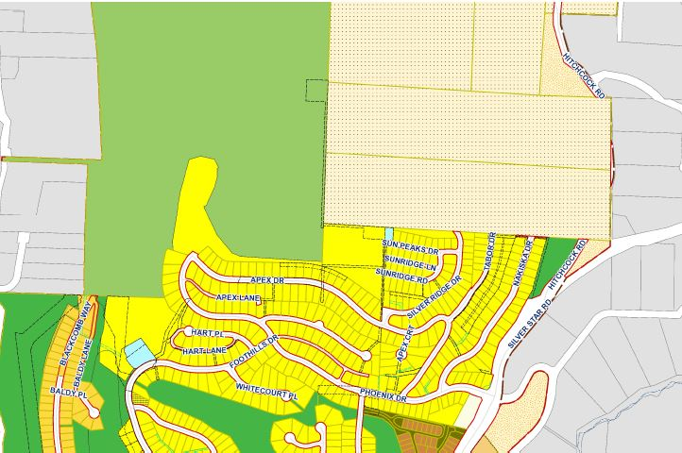
A2
RDNO
SUBJECT PROPERTY
NU NORD
P4
HITCHCOCK RD
P1
R2
SILVERSTAR RD
RDNO
P4 – Utilities P1 - Parks
A2 – Rural Large holdings
R2 – Large Lot Residential
NU NORD – Non-Urban NORD
Zoning Designations

Slide 9
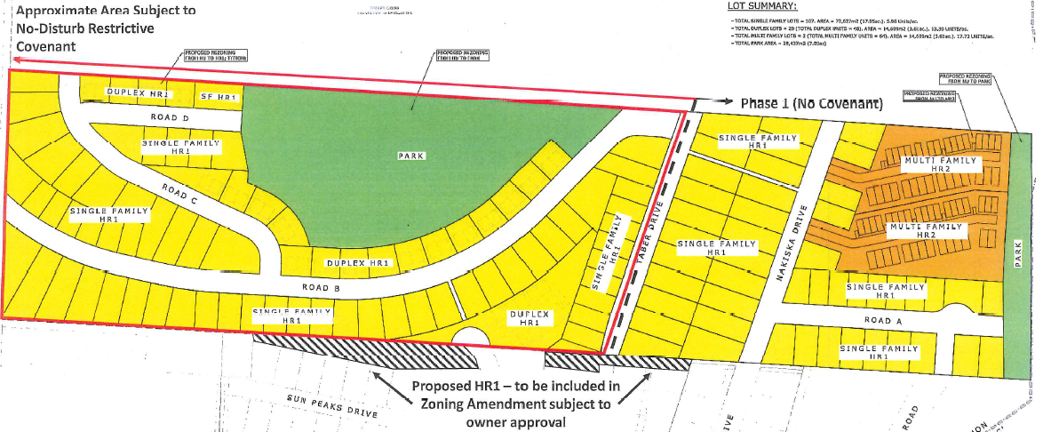
Proposed Zoning Designations

Slide 10
Community Infrastructure &Development Current Planning
Rezoning Application
ZON00296
7250 Hitchcock
October 9, 2018

